Slide 1

Customer Analysis Case Study
Nilanjan Das

Slide 2
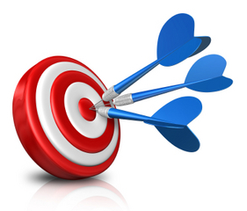
Objective
Recommendations to improve business

Slide 3
Discussions
Two KPIs
Analysis
Recommendations

Slide 4
KPI‘s
Channel wise performance
Market wise performance

Slide 5
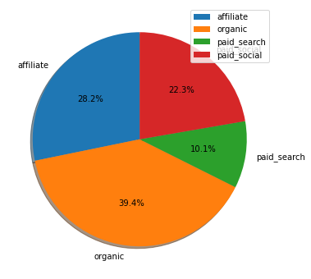
Channel wise Performance

Slide 6
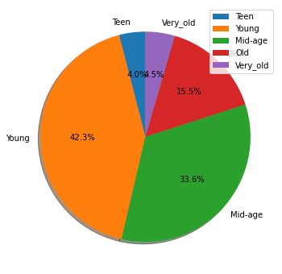
Age group wise performance

Slide 7
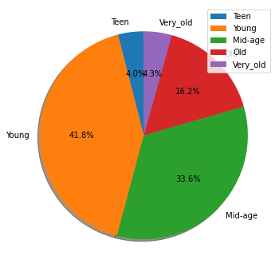
Recommendation (Organic)

Slide 8
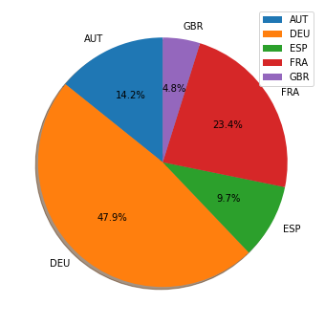
Market wise Performance

Slide 9
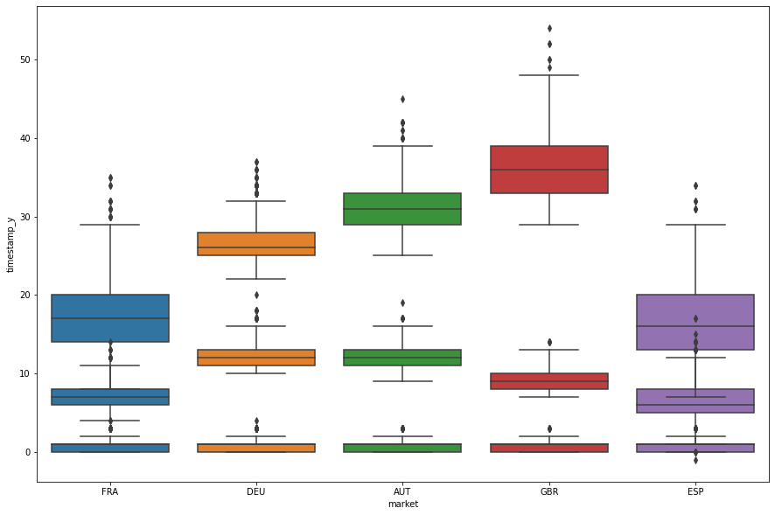
Funnel Steps vs Time (days)

Slide 10
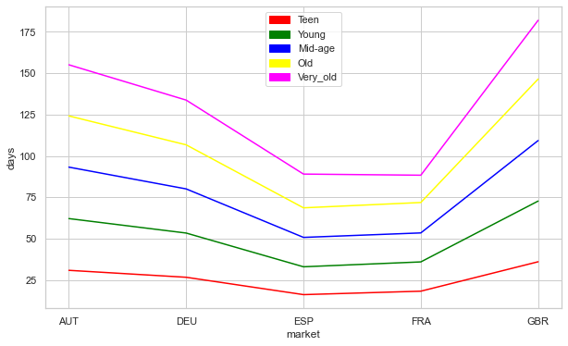
Reason (First deposit)

Slide 11
Recommendations
Attract GB people with offer
First transaction 100$ credit
Refer a friend get 25$

